Slide 1
Training & Placement Cell
49
- Kritika Berry
Prajakta Ghorpade
Manav Tyagi

Slide 2
Contents
Overview of our Project:
Home Page
About Us
Past Recruiters
Current Drives
Upcoming Companies
Contact Us
[ Navigation Bar ]

Slide 3
Question statement
T&P Info Page
Placement is the most important phase of an undergrad student's life. Being able to follow up
on the events can help the student be prepared in advance. Make a T&P web app to keep track
of upcoming, ongoing and previous company tabs
● The web app should show all upcoming, previous and ongoing companies separately
● Each company should have a detailed description which can we viewed on clicking
● The ability to add, delete or update companies
● Extra Credit:
● Make the data persistent
● Give only the admin privilege to add, delete or update companies
● Make the web app responsive to all screens

Slide 4
Our approach
Using Sublime Text Editor version 3.0, we were able to achieve the following requirements:
● The web app should show all upcoming, previous and ongoing companies separately
● Each company should have a detailed description which can we viewed on clicking.
By extensive use of html and css, we have developed a strong frontend approach that consists of a customized template.
The web app consists of different tabs pertaining to the different placement scenarios. In addition, some other features have been built to support a smooth interface for the user.
A preview of the contents in our template have been attached in this presentation. Along with it, we have provided a work flow describing the developing process.
References:
Images and data used in the web app are referenced from:
https://smu.edu.in/smit/know-smit/training-placements/placement-performance-smit.html

Slide 5
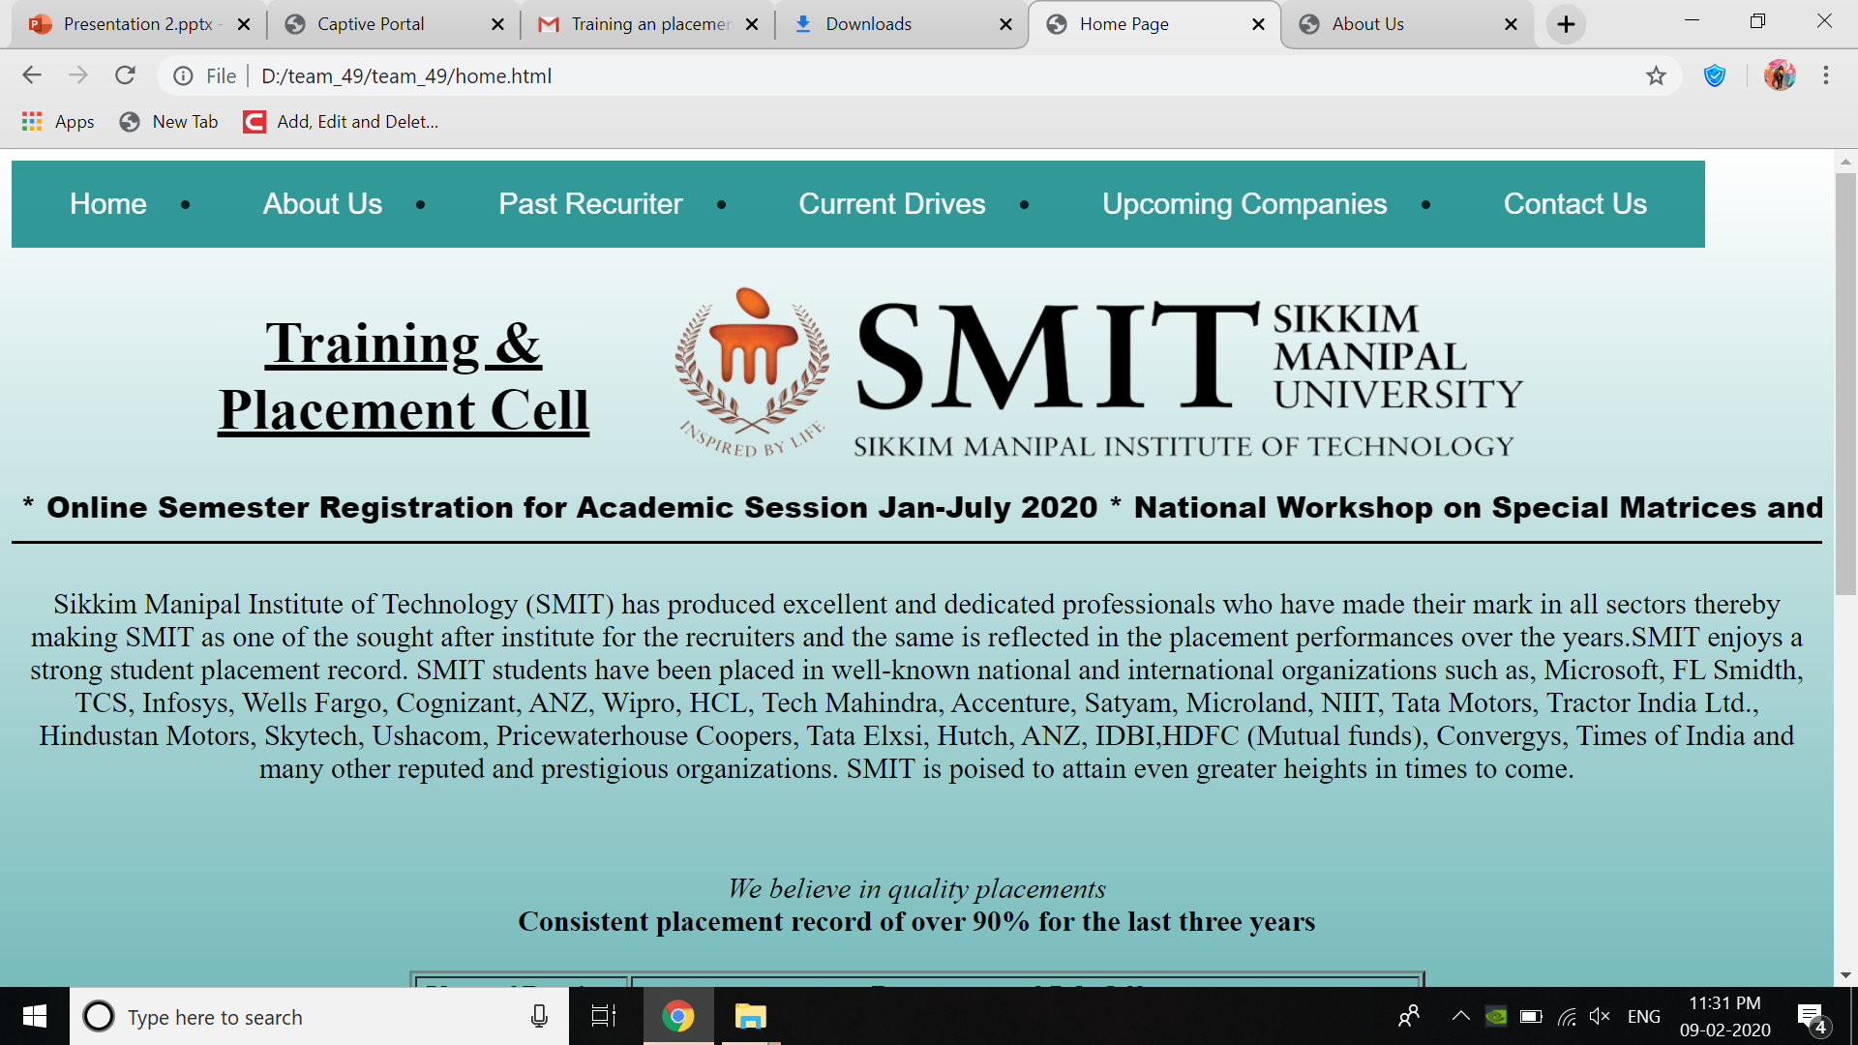
Home page

Slide 6
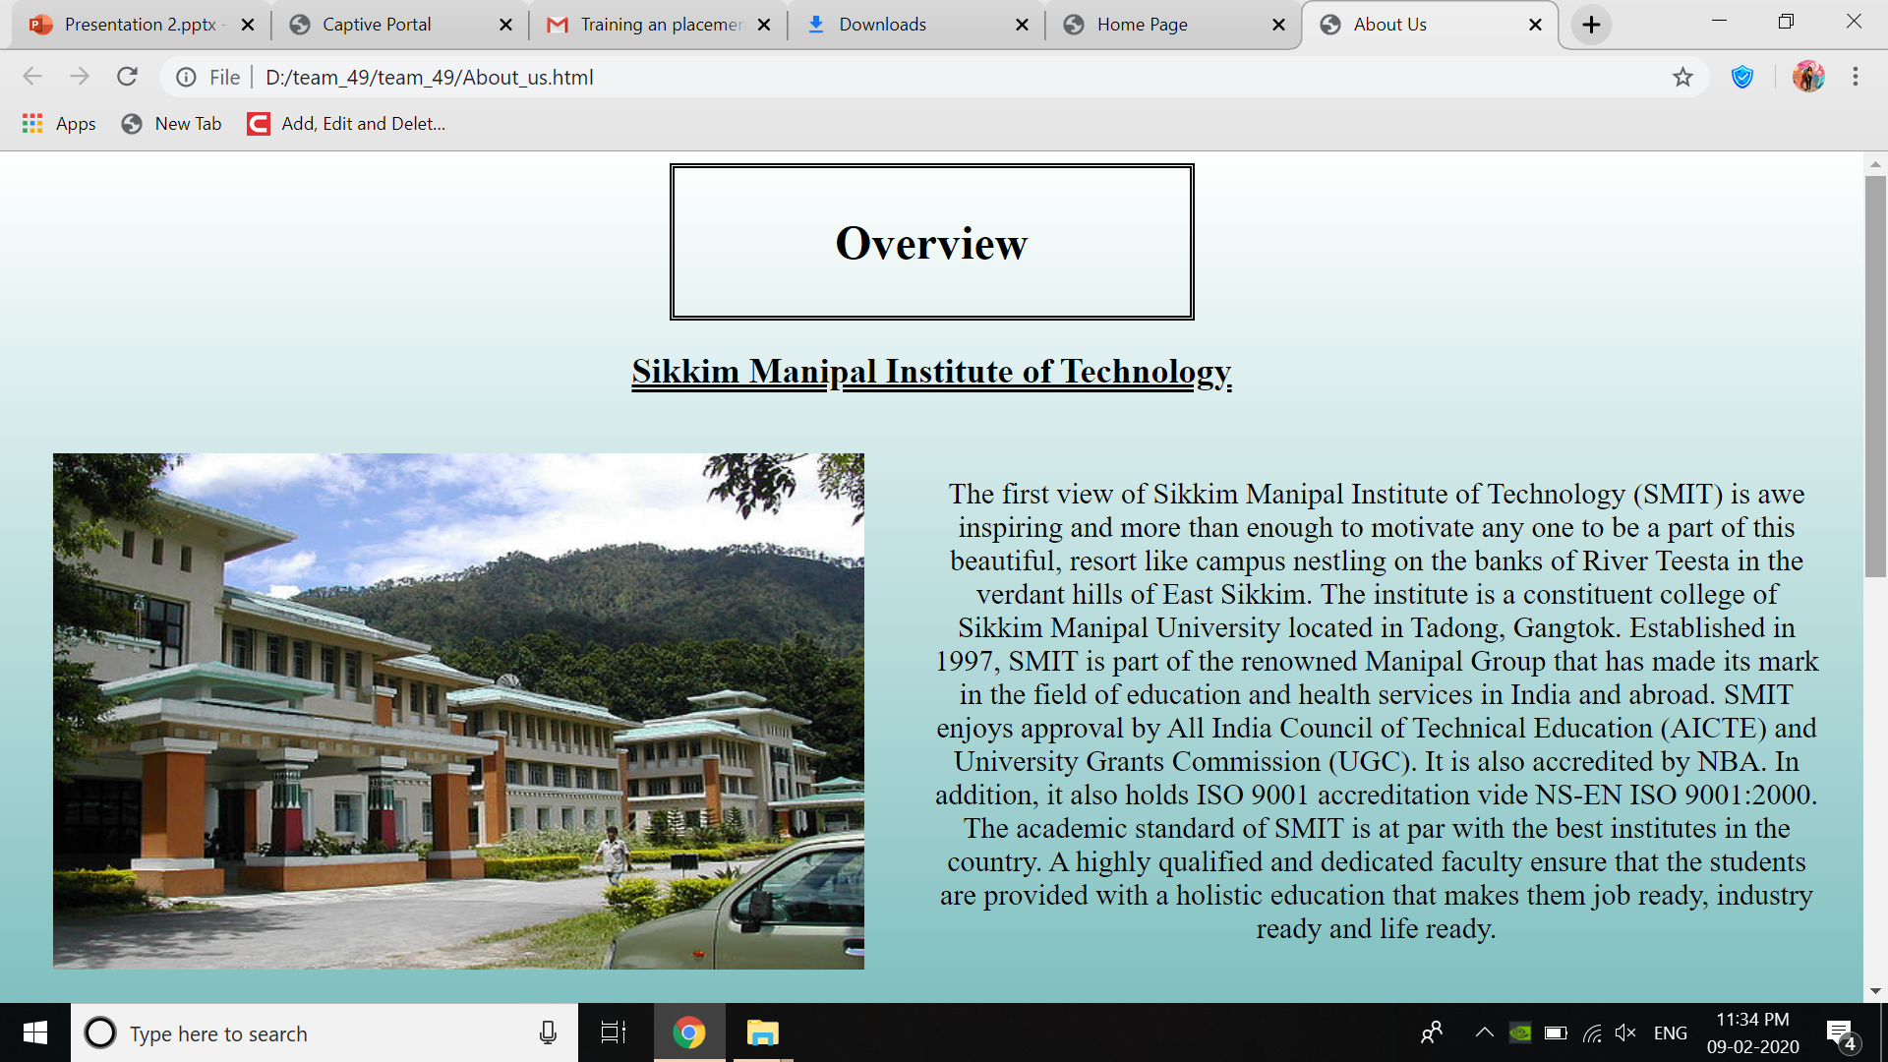
About us

Slide 7
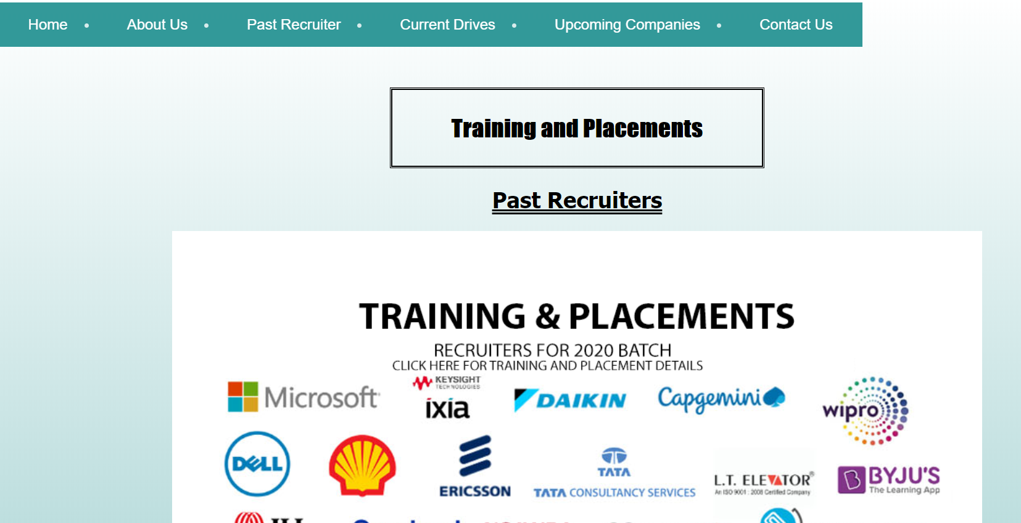
Past recruiters

Slide 8
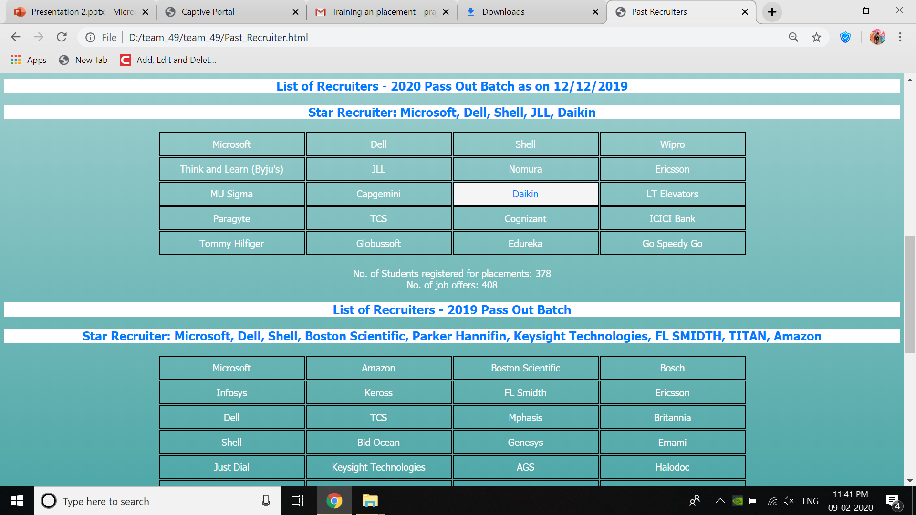

Slide 9
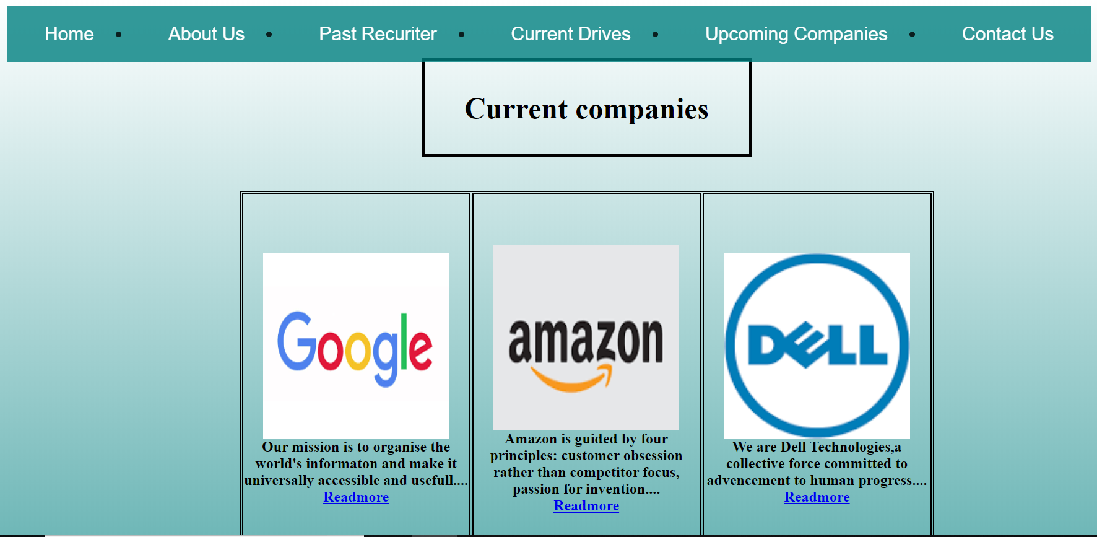
Current drives

Slide 10
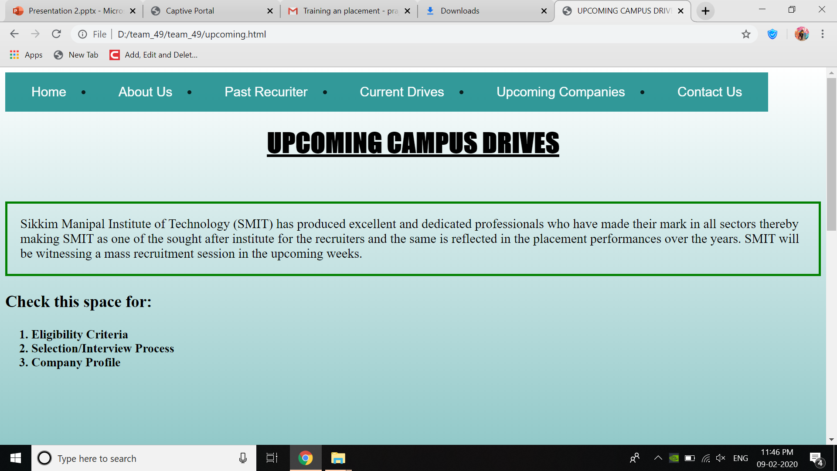
Upcoming campus drives

Slide 11
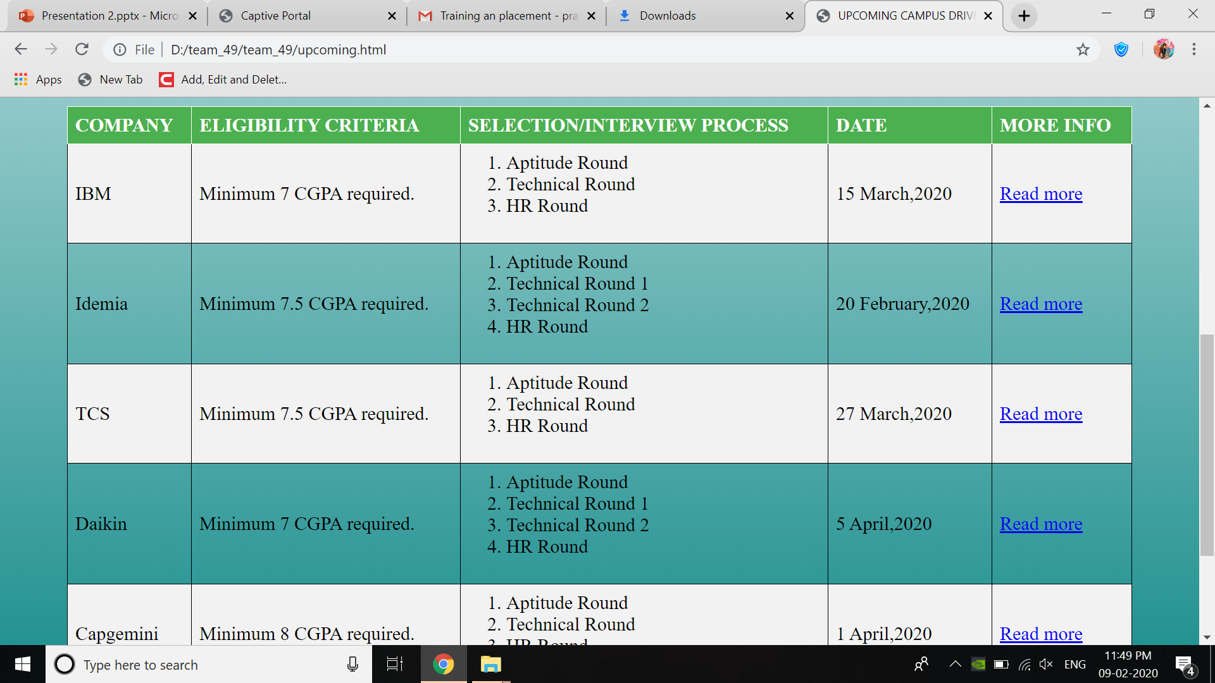

Slide 12
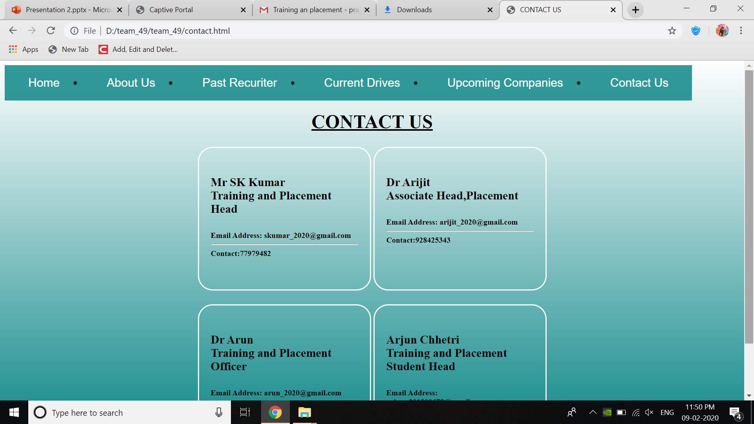
Contact us

Slide 13
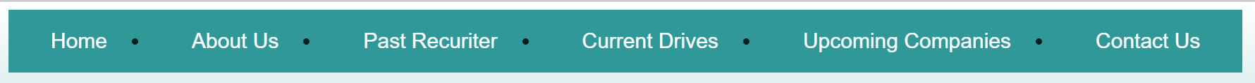
Navigation Bar

Slide 14
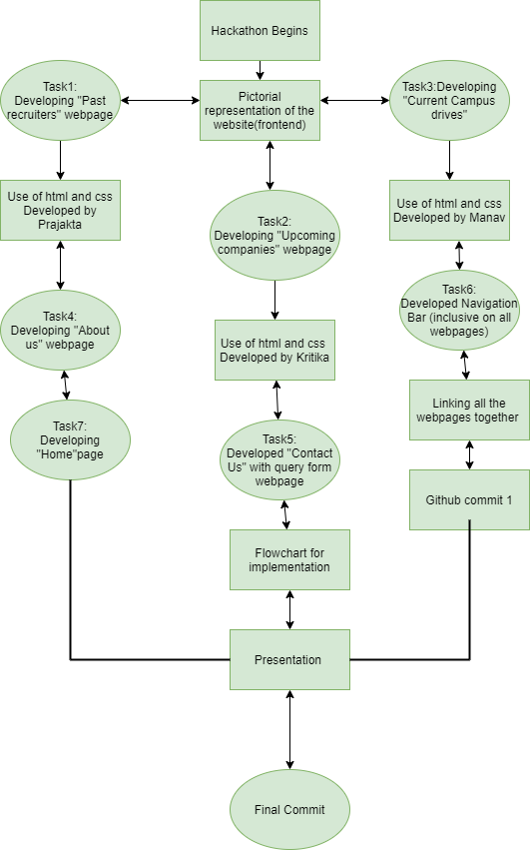

Slide 15
contributions
Prajakta Ghorpade:
Home Page
Past Recruiters
About Us
Presentation
Kritika Berry:
Upcoming Companies
Contact Us
Workflow Diagram
Query Form
Manav Tyagi:
Current Drives
Navigation Bar
GIT setup
Linking web pages &
Final Compiling

Slide 16
Thank you!

